Slide 1
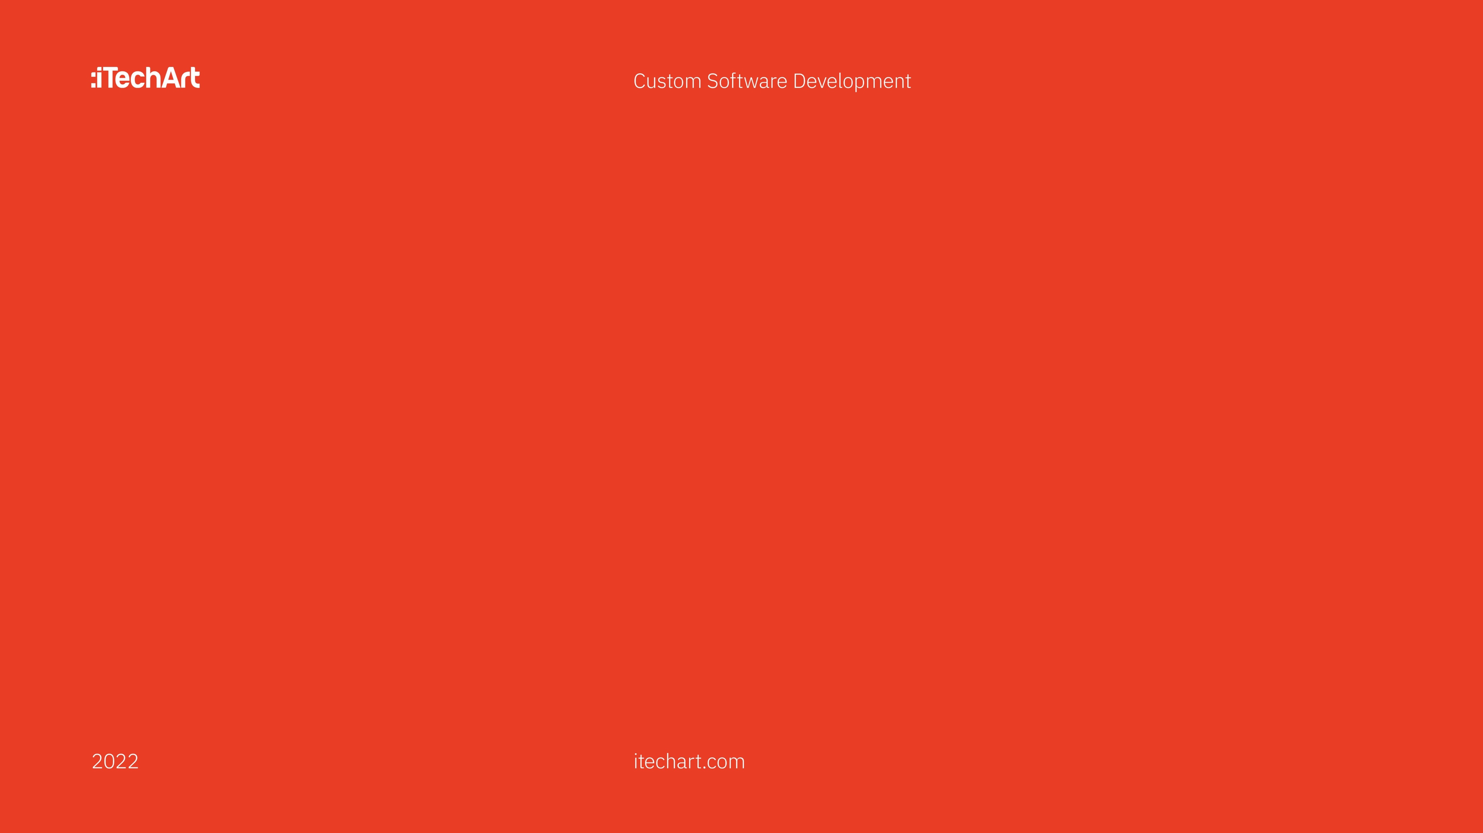

Why do you need to understand the system?
Vitali Kviatkouski
Technical Lead

Slide 2
iTechArt Poland
No agenda slide

Slide 3

iTechArt Poland
BUG

Slide 4
iTechArt Poland
Based on a true story

Slide 5
iTechArt Poland
What does it mean to know the system?
Notes:
Levels
No cats, well known
Lets do example
---
We can know system on different levels
Of course the learning is not a formal science so no strict categorization
So mostly such levels are not standard, but pretty well known when we want to say how good is somebody at this skill
Let’s try to visually show what could be the diff between these levels on the task

Slide 6
iTechArt Poland
Spring Data JPA: Insert child entity
Task:
Given customer id,
insert new order into DB
@Entity class Order {
@Id Integer id;
LocalDate date;
BigDecimal amount;
@ManyToOne
Customer customer;
}
Notes:
So imagine this is your usual working day
And you get the task on your spring data jpa project

Slide 7
iTechArt Poland
Spring Data JPA: Insert child entity
Order order = ...
var cust = customerRepo.findById(customerId);
order.setCustomer(cust);
orderRepo.save(cust);
Notes:
Ok, straightforward
What’s wrong here?
Nothing wrong. It works, it makes its business purpose

Slide 8
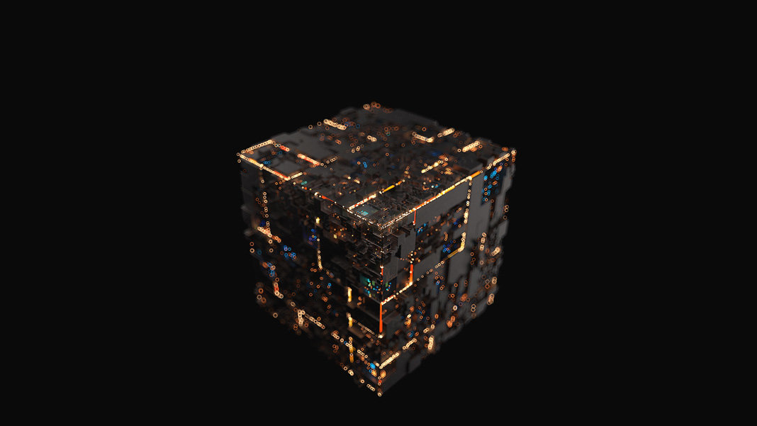

iTechArt Poland
Beginner level
Notes:
API thinking begginner
Black box
---
And this is how we think on the beginner level
We know the API and call it. We don’t think much about what happens below the API
It’s just the sort of black box, we know only what we see

Slide 9


iTechArt Poland
Beginner level
Notes:
My attitude (uncomfortable)
Magical thinking
My example of using api
Modern stack
---
Personally I do not feel comfortable when I know some technology at beginner level and always try to evolve / move to the next level
Mostly because it is so called „magical thinking” when we do not fully understand what;s going on and hoping that series of jumps and screams gives us needed result.
Now it is easy and funny to look back and see why ancient people were doing sacrifice
But as developers we ourselves sometimes behave same way... Remember how many times we were trying to find good combination of API calls to make it working... I can recall many
And many modern technologies and stacks encourage us to stay on this level – Spring Boot with it’s autoconfiguration (when all gears get autoconnected somewhere in the background), clouds and their serverless solutions

Slide 10
iTechArt Poland
Spring Data JPA: Insert child entity
Order order = ...
var cust = customerRepo.findById(customerId);
order.setCustomer(cust);
orderRepo.save(cust);
Notes:
So, nothing wrong here. But could it be better?
!!! INTERACTIVE

Slide 11

iTechArt Poland
Spring Data JPA: Insert child entity
select * from customer where id = 1
Order order = ...
var cust = customerRepo.findById(customerId);
order.setCustomer(cust);
orderRepo.save(cust);
insert into order(...) values (..., customer_id)
Notes:
Go deeper
--
To understand that, we need to look deeper, we need to look into.
Let’s enable sql generation in hibernate and see what are the queries we run
But we don’t use any of the data loaded
To know why we need first queryhat, we need to understand

Slide 12
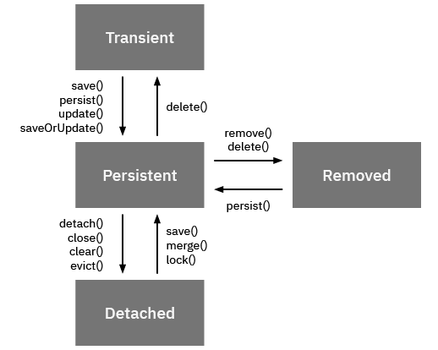
iTechArt Poland
Advanced level
Notes:
When we start to learn the JPA from the concepts and rules it uses, we would know that entity can be in different states
When we save the entity, it goes from transient (non-managed) state to persistent state

Slide 13
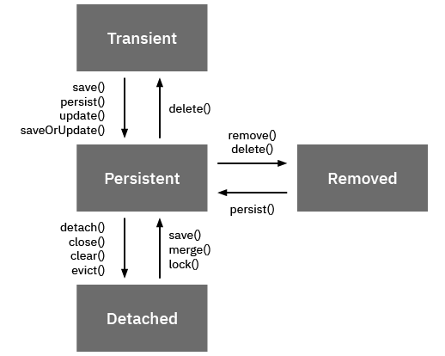
iTechArt Poland
Advanced level
@Entity class Order {
@Id Integer id;
LocalDate date;
BigDecimal amount;
@ManyToOne
Customer customer;
}
Notes:
Can we pretend?
---
But if entity to be persisted has references to other entities, they should be managed at the time we store it in database
Ok, we made the customer managed entity because we loaded it from database, now it’s managed and in the persistent state
But we already know all the info
Shouldn’t be a better way to do that
Maybe we can pretend that we already have a customer object with some id? To have a sort of proxy
And this is the feature of JPA – it allows to create so called proxies – objects marked as Persistent, but created without call to DB
In JPA API it is EntityManager.getReference

Slide 14
iTechArt Poland
Spring Data JPA: Insert child entity
Order order = ...
var cust = customerRepo.getById(customerId);
order.setCustomer(cust);
orderRepo.save(cust);
EntityManager.getReference
Notes:
So changing only one word we get rid of

Slide 15
iTechArt Poland
Understand the system == Architecture
What problem(s) does it solve?
Concepts
Rules
Working parts
Features
List of solutions to common problems
Notes:
So we moved to the second level –
when we understand system,
understand the problem it solves,
what concepts / rules it uses to solve the problem,
what are high-level working parts under the hood
that we should be aware of to use it efficiently

Slide 16
iTechArt Poland
Spring Data JPA: Delete entity
Order order = ...
var cust = customerRepo.findById(customerId);
customerRepo.delete(cust);
Notes:
INTERACTIVE
------------
So this far this good, we optimized our code, throwing away the whole query, what is nice.
Let’s take a look at removing customer by id then
Looks like similar potential optimization possible, right? We have method delete accepting object, but what we really need – just simple delete from where id equals SQL statement
Maybe we can use proxy here?
And here we face with the issue – it seems to adhere to architecture, almost nothing contradicts...
... except the fact that it does not work this way. If proxy is passed, the entity will still be refetched from the DB.
So this is devil in the details and here we can level up to the expert level

Slide 17

iTechArt Poland
Expert level
You know almost everything
Including
All features + their low-level details
Use cases
Can compare to competitors
Issues & bugs

Slide 18
Why evolve?
Lvl 16
Lvl 32
Bulbasaur
Ivysaur
Venusaur
Notes:
WHY UNDERSTAND
WE efficient, faster coding, quality
Code small, clean, readable
Predict and fix upfront issues with NFRs
MORE examples
-----------------
So why we should evolve, develop ourselves and try to reach these new levels?
To understand the system better ... but for what?
We’ve already seen example where it helps us.
It makes us more efficient, allow to write code faster and with the quality we haven’t before.
It makes our code small, clean, readable and following best practices
It helps to predict and fix upfront many issues related to what we call non-functional requirements – security, performance etc
Let’s review couple of other examples

Slide 19
iTechArt Poland
Example: classic example with JPA
@Entity class Customer {
@Id Integer id;
String name;
@OneToMany(
mappedBy="customer")
List<Order> orders;
}
@Entity class Order {
@Id Integer id;
LocalDate date;
BigDecimal amount;
@ManyToOne
Customer customer;
}
@Service
class OrderService {
@Autowired CustomerRepo custRepo;
public int calcSum() {
return
custRepo.findAll().stream()
.flatMap(cust -> cust.getOrders().stream())
.mapToInt(order -> order.getAmount())
.sum();
}
}
Notes:
INTERACTIVE
----------------
So what’s wrong here
Ok this is classic example of N+1 loading problem
Note that from functional (business logic) perspective it works fine – no logical bugs
But we send to database as many sql queries as we have orders return by 1st query
But how do we know there is such issue
You can use two ways
Beginner level: actually you cannot spot it until you enable sql logs and start digging. This is a good example where lack of architecture knowledge hits you
Advanced level: how it works on the advanced level, let’s try to model it

Slide 20
iTechArt Poland
Example: classic example with JPA
@Entity class Customer {
@Id Integer id;
String name;
@OneToMany(
mappedBy="customer")
List<Order> orders;
}
@Entity class Order {
@Id Integer id;
LocalDate date;
BigDecimal amount;
@ManyToOne
Customer customer;
}
@Service
class OrderService {
@Autowired CustomerRepo custRepo;
public int calcSum() {
return
custRepo.findAll().stream()
.flatMap(cust -> cust.getOrders().stream())
.mapToInt(order -> order.getAmount())
.sum();
}
}
select * from customer
select * from order where cust_id = 100
select * from order where cust_ id = 101
....
select * from order where cust_ id = 150 (N+1)
Notes:
N+1 for beginner & for advanced
-------------------
So what’s wrong here
Ok this is classic example of N+1 loading problem
Note that from functional (business logic) perspective it works fine – no logical bugs
But we send to database as many sql queries as we have orders return by 1st query
But how do we know there is such issue
You can use two ways
Beginner level: actually you cannot spot it until you enable sql logs and start digging. This is a good example where lack of architecture knowledge hits you
Advanced level: how it works on the advanced level, let’s try to model it

Slide 21
iTechArt Poland
Example: classic example with JPA
@Entity class Order {
@Id Integer id;
LocalDate date;
BigDecimal amount;
@ManyToOne
Customer customer;
}
@Entity class Customer {
@Id Integer id;
String name;
@OneToMany(
mappedBy="customer")
List<Order> orders;
}
Load Order:
select * from order join customer where order.id=?
Notes:
ARCH level – know the relations (composition etc)
----
Now let’s try to model your thinking on the architectural level
Ok, we know each entity is mapped to database table
So every time we load an entity from the database, hibernate creates SQL query
And would be great if you start imagining what could be this sql statement
But the nicest part of ORM is the modeling entities in composition and hierarchies
Like here
For example, if we load the OrderItemEntity, what would be the SQL?
Ok it will be a join, pretty expectable
What if I load OrderEntity

Slide 22
iTechArt Poland
Example: classic example with JPA
@Entity class Order {
@Id Integer id;
LocalDate date;
BigDecimal amount;
@ManyToOne
Customer customer;
}
@Entity class Customer {
@Id Integer id;
String name;
@OneToMany(
mappedBy="customer")
List<Order> orders;
}
Load Customer:
select * from customer where id = ?
Notes:
Now let’s try to model your thinking on the architectural level
Ok, we know each entity is mapped to database table
So every time we load an entity from the database, hibernate creates SQL query
And would be great if you start imagining what could be this sql statement
But the nicest part of ORM is the modeling entities in composition and hierarchies
Like here
For example, if we load the OrderItemEntity, what would be the SQL?
Ok it will be a join, pretty expectable
What if I load OrderEntity

Slide 23
iTechArt Poland
Example: classic example with JPA
JPA feature – Lazy Loading on related entities
@OneToMany + @ManyToMany by def lazy
@OneToOne + @OneToMany by def eager, can be lazy
@Lob (BLOB) can be lazy
JPA feature - Change lazy to eager fetching
Attribute on annotation
Using special keyword in JPQL/Criteria API when joining
EntityGraph support
Notes:
So this is the example how to learn the system on architecture / feature level
Just make a list of what features there are
So we know there is lazy loading on related entities – would be nice to remember which ones, but this comes second
Remembering exact annotations / apis is good but only when you know the concepts + features
Otherwise it would be just learning the API what is again sort of magical thinking
And if you are not satisfied with lazy loading JPA gives a way to change it to eager loading (which one will do the join – and N+1 query will be transformed into 1)
You can do it 3 ways – and I do not explain it in details because to know exact API again is nice, but when you know there is a feature to support that it is easy to google
Even if you do not remember it exactly

Slide 24
How about security?
Notes:
Like Spring MVC
-----------
Ok, this far this good. We’ve seen performance issues only. How about for say security?
The method with @MessageMapping is used to interactively communicate to the user.
User wants to send a message to chat, we send back it back
With one small difference – what we return from the method is broadcasted to all subscribed user, not only to this one
This is where it matters that connection is persistent – we know all the connected clients and can send them data
Very handy for our kind of application (chat)
But we also can send message to this connected client only
Here we try to implement following logic: all the messages posted by client are broadcasted to all connected clients in this chat if it is not about NFT hype. For NFT message we warn client who sends the message
ALL of it is very much alike the spring mvc framework

Slide 25
Example: Spring Websockets - Beginner
@MessageMapping("/chats/{id}")
public Message addMessage(
@DestinationVariable("id") int chatId,
@Header("simpSessionId") String sessionId,
String msg) {
if (msg.toLowerCase().contains("NFT")) {
tpl.convertAndSendToUser(sessionId, "/topic/chats/" + chatId,
“choose another topic");
return null;
} else {
chatRepo.addMessages(chatId, new Message(msg));
return new Message(msg);
}
}
Handling for user-side messages
Chat id will be here
Send back message to that user
Send back to users so all can see
Notes:
Like Spring MVC
-----------
Ok, this far this good. We’ve seen performance issues only. How about for say security?
The method with @MessageMapping is used to interactively communicate to the user.
User wants to send a message to chat, we send back it back
With one small difference – what we return from the method is broadcasted to all subscribed user, not only to this one
This is where it matters that connection is persistent – we know all the connected clients and can send them data
Very handy for our kind of application (chat)
But we also can send message to this connected client only
Here we try to implement following logic: all the messages posted by client are broadcasted to all connected clients in this chat if it is not about NFT hype. For NFT message we warn client who sends the message
ALL of it is very much alike the spring mvc framework

Slide 26
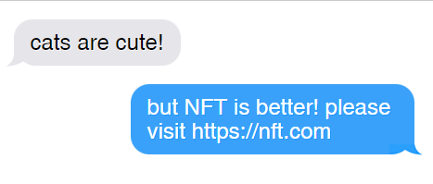
Example: Security Breach
iTechArt Poland
Notes:
The method with @MessageMapping is used to interactively communicate to the user.
User wants to send a message to chat, we send back it back
With one small difference – what we return from the method is broadcasted to all subscribed user, not only to this one
This is where it matters that connection is persistent – we know all the connected clients and can send them data
Very handy for our kind of application (chat)
But we also can send message to this connected client only
Here we try to implement following logic: all the messages posted by client are broadcasted to all connected clients in this chat if it is not about NFT hype. For NFT message we warn client who sends the message
ALL of it is very much alike the spring mvc framework

Slide 27
Example: Spring Websockets - Advanced
Our custom handler for /app/chats/{id}
@MessageMapping("/chats/{id}")
public Message addMessage(
@DestinationVariable("id") int chatId,
@Header("simpSessionId") String sessionId,
String msg) {
if (msg.toLowerCase().contains("NFT")) {
tpl.convertAndSendToUser(sessionId, "/topic/chats/" + chatId,
“choose another topic");
return null;
} else {
chatRepo.addMessages(chatId, new Message(msg));
return new Message(msg);
}
}
Means no message will be returned and broadcasted
Broadcasted to all subscribers of /topic/chats/{id}
Notes:
Beginner level does not help
---------
The method with @MessageMapping is used to interactively communicate to the user.
User wants to send a message to chat, we send back it back
With one small difference – what we return from the method is broadcasted to all subscribed user, not only to this one
This is where it matters that connection is persistent – we know all the connected clients and can send them data
Very handy for our kind of application (chat)
But we also can send message to this connected client only
Here we try to implement following logic: all the messages posted by client are broadcasted to all connected clients in this chat if it is not about NFT hype. For NFT message we warn client who sends the message
ALL of it is very much alike the spring mvc framework

Slide 28
Example: Spring Websockets - Advanced
iTechArt Poland
const stomp = new StompJs.Client();
stomp.brokerURL = url;
function onMessage(message) {
console.log("Got message", message.body);
}
stomp.onConnect = () => {
stomp.subscribe('/app/chats/6', onMessage);
stomp.subscribe('/user/topic/chats/6', onMessage);
stomp.subscribe('/topic/chats/6', onMessage);
};
stomp.activate();
stomp.publish({destination: '/app/chats/6’,
body: ‘hello’ });

Slide 29
We need more power!
Notes:
INTERACTIVE – what’s wrong here? Why this happens?

Slide 30
Example: Spring Websockets - Advanced
iTechArt Poland
/app/chats/6
/user/topic/chats/6
/topic/chats/6
Notes:
Same basepath, different prefixes
---------
If we take a look at all 3 topics we see that all of them have some base part (the same for all 3) and some prefix
So they are related to each other
Let’s to which ones we need to subscribe and to which ones we can send the message

Slide 31
Example: Spring Websockets - Advanced
iTechArt Poland
SUBSCRIBE
to trigger @SubcribeMapping
receive initial data
/app/chats/6
/user/topic/chats/6
/topic/chats/6
To get private messages
@SendToUser or
convertAndSendToUser
To get broadcast messages
(for all subscribers)
@SendTo or convertAndSend
Notes:
If we take a look at all 3 topics we see that all of them have some base part (the same for all 3) and some prefix
So they are related to each other
Let’s to which ones we need to subscribe and to which ones we can send the message

Slide 32
Example: Spring Websockets - Advanced
iTechArt Poland
SEND
/app/chats/6
/user/topic/chats/6
/topic/chats/6
to trigger @MessageMapping
NOT USED
Broadcast messages?
Notes:
So it appears that we send message to one topic and receive from the another. They both use the same base path, but still it is rather confusing
Maybe it will be simpler if we take a look at the official diagram showing the flow

Slide 33
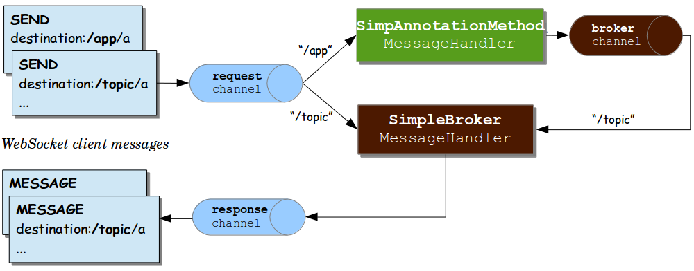
Example: Spring Websockets - Advanced
iTechArt Poland
Notes:
So when we send a message it comes to the request channel and then (depending on where we send the message – to the /app prefix or /topic prefix it goes one or another route)
But this picture is still imho a bit confusing, let’s redraw it slightly different way and split into two scenarios

Slide 34
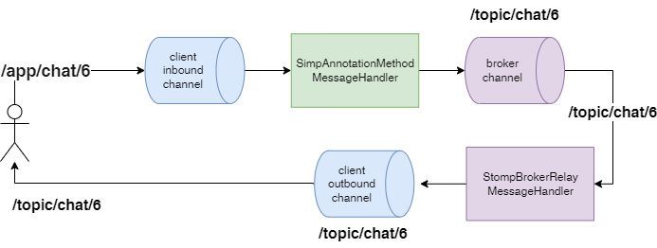
iTechArt Poland
Example: Spring Websockets - Advanced
Notes:
APP prefix, coloring, GREEN block
---
Pretty much the same but we also showing the name of the destination on each step
And this shows only 1st scenario – when we send a message to the /app prefixed topic
Note the coloring of the blocks – blue are the channels (term from spring integration) that are facing the user (input and output channels), purple are the internal components related to internal in memory broker (remember STOMP is for working with message brokers, so it’s expectable spring websockets will resemble both spring mvc and message broker at the same time), green (! What is really important) is some place where you add your code
This also probably reminds you some Spring MVC Front Controller implementation diagram – there we also had many moving parts, but you as developer had to implement only 1 component of it
But this is about sending message to the /app prefix

Slide 35
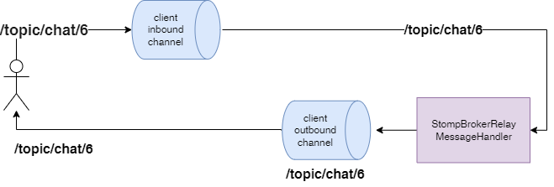
iTechArt Poland
Example: Spring Websockets - Advanced
Notes:
INTERACTIVE – what’s changed, STOMP
--------------
Much simpler, but here you may start to have some worries about how it would work
Let’s follow the flow of the thought we might have at this point
Ok, I remember it uses STOMP protocol, which is for message broker interaction
So destination like /topic/chat/6 acts similar to JMS queue (more like JMS topic or Kafka topic), so as user I can send the message to the topic and all subscribers can receive it...
And also I do not see the green block...
That means that I have no control on the message sent...

Slide 36
Example: Spring Websockets - Advanced
iTechArt Poland
@MessageMapping("/chats/{id}")
public Message addMessage(@DestinationVariable("id") int chatId,
@Header("simpSessionId") String sId,
String msg) {
if (msg.toLowerCase().contains("NFT")) {
tpl.convertAndSendToUser(sId, "/topic/chats/" + chatId,
“choose another topic");
return null;
} else {
chatRepo.addMessages(chatId, new Message(msg));
return new Message(msg);
}
}
Notes:
WAY to bypass
---
We initially wrote this code to validate and process the message before broadcasting it
And now we are saying there is a way to bypass it???

Slide 37
iTechArt Poland
Example: Spring Websockets - Advanced
/app/chat/6 => /topic/chat/6
Notes:
And actually it’s true. More-less experienced user changing the javascript can force application to post messages to topic prefixed destination and bypass the validation
This might not look too scary but imagine if your chat shows not only the message but also information about who sent the message (name of user, type – admin / user)
So what if hacker sends a message from the admin name saying „come on guys, we are gathering money to pay for the servers, pls send me 5$ to this account”
It could be a big security issue!
And adding authorization (tokens and so on) does not really help here – we need to add authorization, but this exact security issue happens because of another reason. It happens because of different architecture of spring websockets

Slide 38
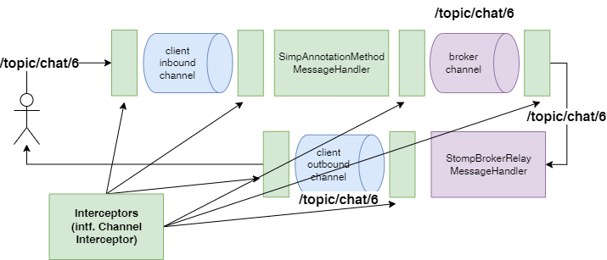
Example: Spring Websockets - Advanced
iTechArt Poland
Notes:
How to fix it – that’s pretty easy actually
Remember we were talking about spring-messaging in the heart of spring websockets
And that spring messaging was born from the spring integrations
And we probably know that spring integrations allows to specify interceptors (some sort of AOP) on the channels
So maybe we have some sort of interceptors here?
If we don’t know spring integrations, maybe we can recall that Spring MVC had interceptors, maybe we have them here too?
And we do. Before message lands on the channel and after it is taken from the channel, we can add some logic

Slide 39
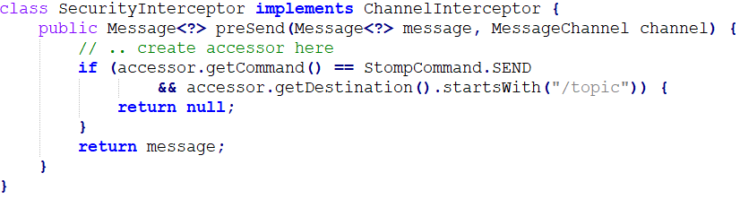
Example: Spring Websockets - Advanced
iTechArt Poland
Using client inbound channel interceptor
Using spring security
Notes:
SIMPL BUT NO DOCS
-------------
The fix is simple, and yes documentation of spring security talks about it
But getting started examples on the web do not pay attention to it
What together to the fact that architecture is different, vector of attacks is different and that not much attention is put onto security leaves us with huge security holes in apps

Slide 40
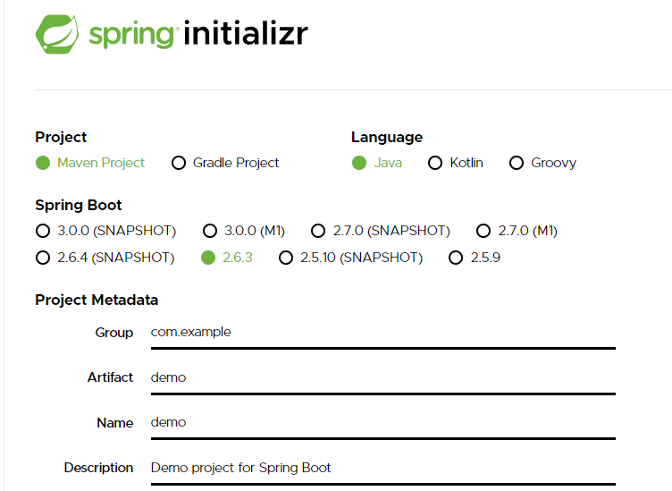
Spring boot magic
iTechArt Poland
Notes:
Use features!!!
This far we talked about issues mainly. How about reusing code right way to make it readable and small

Slide 41
Spring boot magic
iTechArt Poland
@SpringBootApplication
public class DemoApplication {
public static void main(String[] a) {
SpringApplication.run(DemoApplication.class, a);
}
}

Slide 42
Spring boot magic
What is inside?
Notes:
It is even more important not what’s inside but how that knowledge helps us

Slide 43
Example: Database multitenancy
iTechArt Poland
Inputs and Requirements
Approach: separate databases
same db instance
Microservice architecture
Step-by-step migration of each microservice
DB config in shared library

Slide 44
iTechArt Poland
Example: Database multitenancy
Tenant1DB
X-Tenant-Id
Microservice
Tenant2DB
Tenant Config

Slide 45
iTechArt Poland
Example: Database multitenancy
class ThreadLocalSelector {
public DataSource getDataSource() {
var tenantId = TenantThreadLocal.get();
var cfg = config.get(tenantId);
return new DataSource(cfg...);
}
}

Slide 46
How to plug in?

Slide 47
iTechArt Poland
How to plug in?
@Configuration
class DBConf {
@Autowired
ThreadLocalSelector threadSelector;
@Bean DataSource tenantDataSource() {
return threadSelector.getDataSource();
}

Slide 48
iTechArt Poland
Why does it work?
Where is old DataSource bean?
We know it should exist
Aren’t there conflicts between 2 beans?
What DataSource will be used by
TransactionManager
EntityManagerFactory
Notes:
INTERACTIVE

Slide 49
iTechArt Poland
Why does it work?
Where is old DataSource bean?
We know it should exist
Aren’t there conflicts between 2 beans?
What DataSource will be used by
TransactionManager
EntityManagerFactory
@ConditionalOnBean
Notes:
@conditionalonbean creates a bean only when no custom bean provided
But how we can be sure that OUR datasource would be used

Slide 50
iTechArt Poland
Why does it work?
Where is old DataSource bean?
We know it should exist
Aren’t there conflicts between 2 beans?
What DataSource will be used by
TransactionManager
EntityManagerFactory
@ConditionalOnBean
Spring Dependency Injection
Notes:
Everything good? Not exactly – we forgot that our bean should replace default (non multitenant) implementation only when it’s enabled (
so for one microservice using this shared config we use it, for another don’t

Slide 51
iTechArt Poland
How to plug in?
@Configuration
class DBConf {
@Value(„${use.tenants}”) boolean tenants;
ThreadLocalSelector threadSelector;
@Bean DataSource tenantDataSource() {
return tenants ? threadSelector.getDataSource()
: new NormalDataSource();
}
}
Notes:
Ok, we probably can use property file prop like that
INTERACTIVE – could it be better? What you dislike?

Slide 52
iTechArt Poland
How to plug in?
@Configuration @Profile(„tenants”)
class DBConf {
ThreadLocalSelector threadSelector;
@Bean DataSource tenantDataSource() {
return threadSelector.getDataSource();
}
}
Notes:
Here we may come with profile proposal, which is a working solution – we will override datasource with multitenant version only when profile is set
...but we want something more – as turning it on and off sounds like a feature flag and we want smth more flexible
We’ve already seen @ConditionalOnBean Annotation. Do we have it’s sisters? Similar annotations

Slide 53
iTechArt Poland
How to plug in?
@Configuration
@ConditionalOnProperty(„use.tenants”)
class DBConf {
ThreadLocalSelector threadSelector;
@Bean DataSource tenantDataSource() {
return threadSelector.getDataSource();
}
}

Slide 54
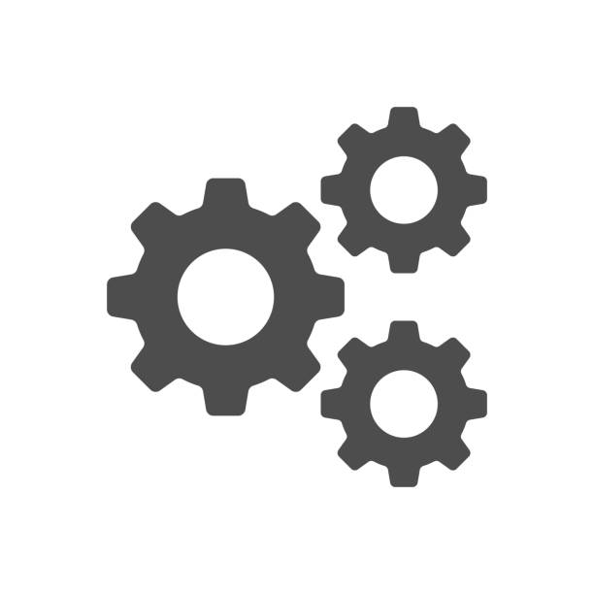

Notes:
So this is how using the knowledge of architecture, logic and common sense we can find issues (performance / security) that you would not notice on the beginner level

Slide 55
iTechArt Poland
What to do?
Beginner Level
Getting Started example
Advanced level
Lot of practice
Architecture
Redraw / Redescribe for yourself
Share the knowledge
Feature list
Cheat sheet
Notes:
So this far we saw what could be the issues and how to spot them with decent knowledge of the frameworks
But how to master the framework, how to move from this beginner level to advanced?
So maybe I can recommend a tool you can use to learn new technology
Make multiple passes
1st to beginner level – to get familiar, start using
Do not spend too much time
2nd to know the architecture
Check the architecture
Try to change it better for your understanding form
For example like me redrawing the diragram into 2 use cases
Try to explain it to somebody
Make a list of features
Feature in form „short feature descr and what problem it solves”
For example, spring data has @CreatedBy/@LastModifiedBy annos for simple audit. Annotations is a short descr and the need for simple audit it\s a problem to solve
You can use it later – when you face some issue that you need to solve, check the feature list of framework, maybe it already has smth you
As result, you can have a small checklist you can ping to the wall near your desk
So, advance yourself and become the strongest developer ever!

Slide 56
Notes:
So when we send a message it comes to the request channel and then (depending on where we send the message – to the /app prefix or /topic prefix it goes one or another route)
But this picture is still imho a bit confusing, let’s redraw it slightly different way and split into two scenarios

Slide 57
iTechArt Poland
Feature list
JPA feature – Lazy Loading on related entities
@OneToMany + @ManyToMany by def lazy
@OneToOne + @OneToMany by def eager, can be lazy
@Lob (BLOB) can be lazy
JPA feature - Change lazy to eager fetching
Attribute on annotation
Using special keyword in JPQL/Criteria API when joining
EntityGraph support
Notes:
So this is the example how to learn the system on architecture / feature level
Just make a list of what features there are
So we know there is lazy loading on related entities – would be nice to remember which ones, but this comes second
Remembering exact annotations / apis is good but only when you know the concepts + features
Otherwise it would be just learning the API what is again sort of magical thinking
And if you are not satisfied with lazy loading JPA gives a way to change it to eager loading (which one will do the join – and N+1 query will be transformed into 1)
You can do it 3 ways – and I do not explain it in details because to know exact API again is nice, but when you know there is a feature to support that it is easy to google
Even if you do not remember it exactly

Slide 58
BUG

Slide 59


Thank you!
2022
hello@itechart-group.com
itechart.com

